Slide 1
Software Testing
CSSE3113 – Introduction to Software Engineering
How to write Test Cases

Slide 2
What Is a Test Case in Software?
A test case measure functionality across a set of actions or conditions to verify the expected result. They apply to any software application, can use manual testing or an automated test, and can make use of test case management tools.

Slide 3
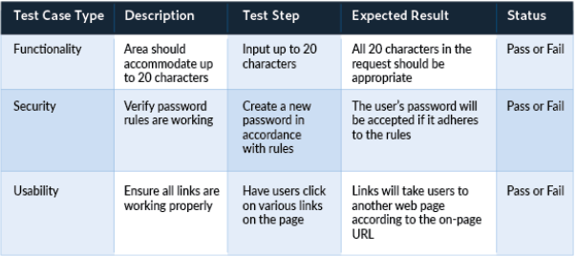
Different Types of Test Cases
Some common test case examples would be the following:

Slide 4
How to Write Software Test Cases
Every test case can be broken down into 8 basic steps.
Step 1: Test Case ID
Test cases should all bear unique IDs to represent them.
Step 2: Test Description
This description should detail what unit, feature, or function is being tested or what is being verified.
Step 3: Assumptions and Pre-Conditions
This entails any conditions to be met before test case execution. One example would be requiring a valid account for a login.

Slide 5
How to Write Software Test Cases
Step 4: Test Data
This relates to the variables and their values in the test case. In the example of an email login, it would be the username and password for the account.
Step 5: Steps to be Executed
These should be easily repeatable steps as executed from the end user’s perspective. For instance, a test case for logging into an email server might include these steps:
Open email server web page.
Enter username.
Enter password.
Click “Enter” or “Login” button.

Slide 6
How to Write Software Test Cases
Step 6: Expected Result
This indicates the result expected after the test case step execution. Upon entering the right login information, the expected result would be a successful login.
Step 7: Actual Result and Post-Conditions
As compared to the expected result, we can determine the status of the test case. In the case of the email login, the user would either be successfully logged in or not. The post-condition is what happens as a result of the step execution such as being redirected to the email inbox.
Step 8: Pass/Fail
Determining the pass/fail status depends on how the expected result and the actual result compare to each other.

